Slide 1

Option Pricing
MAL4330 – Introduction to Financial Engineering
Group – 07

Slide 2
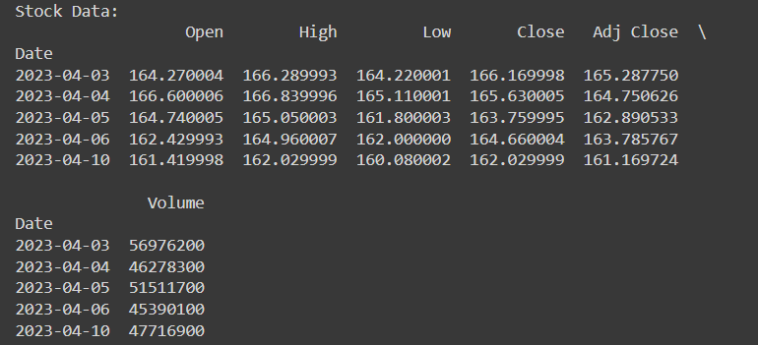
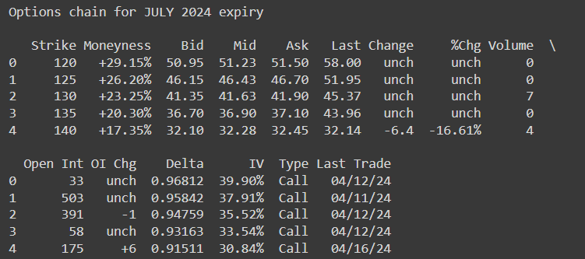
Stock and Option’s History
We have chosen Apple stock and options for our analysis.
Options data used have expiry in July 2024, October 2024, and March 2025.

Slide 3
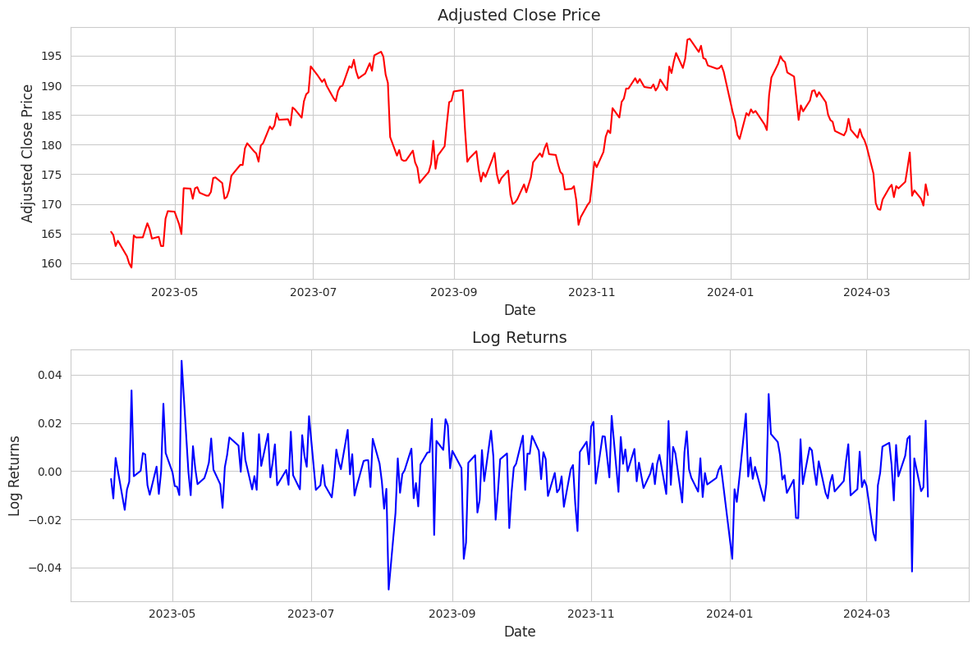


Annual Volatility & Treasury Rate
We have calculated the log-returns of the stock for each day.
Used this to find the annual volatility.
The US treasury rate is taken as 0.0456

Slide 4
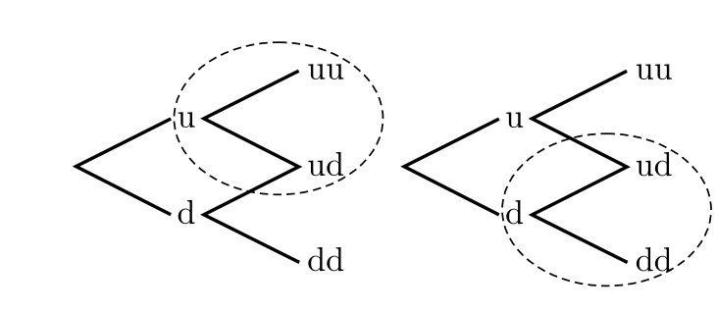
Binomial Model
Certain assumptions :
The two possible prices are the up-price and down-price.
No dividends are paid out during the option’s life.
The risk-free rate is constant throughout the life of the option.
Investors are risk neutral.
All trees are built from four parameters (u, d, p, and q).
Branching in the two-step binomial tree

Slide 5
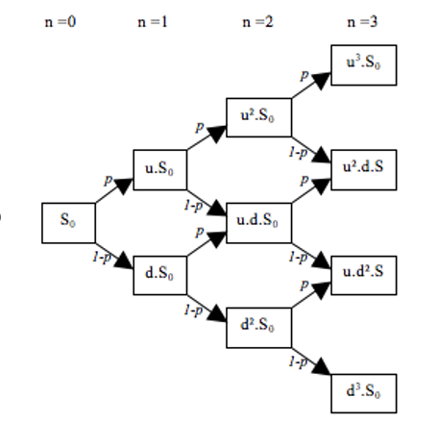
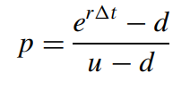
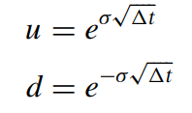
Binomial Model
Implemented the binomial model for predicting the call and put prices of the stock given these input parameters.
Input Parameters:
S0: Current stock price
K: Strike price
T: Time to maturity (in years)
r: Risk-free interest rate
sigma: Volatility of the stock
N: Number of time steps
option_type: Type of option, either 'call' or 'put'
Output:
European option price

Slide 6
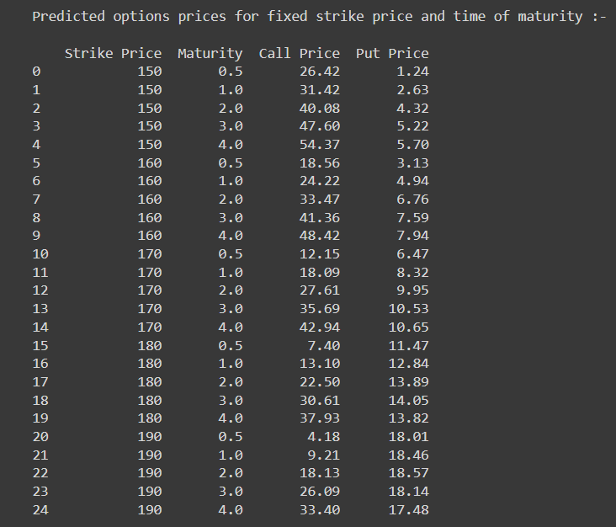
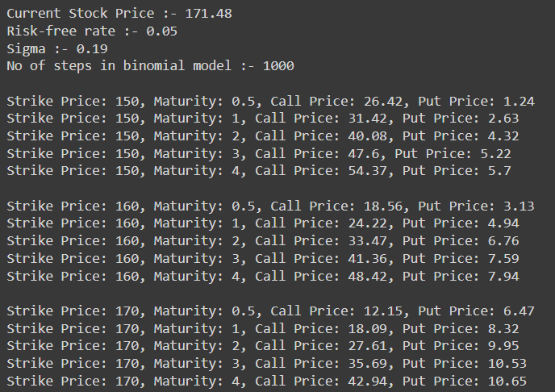
Call and Put Option Prices
We have estimated the call and put prices i.e. C(0) and P(0) for different strike prices and time of maturities.
We have used the binomial model for the calculation of call and put options prices.
Notes:
Cox–Ross–Rubinstein Formula

Slide 7
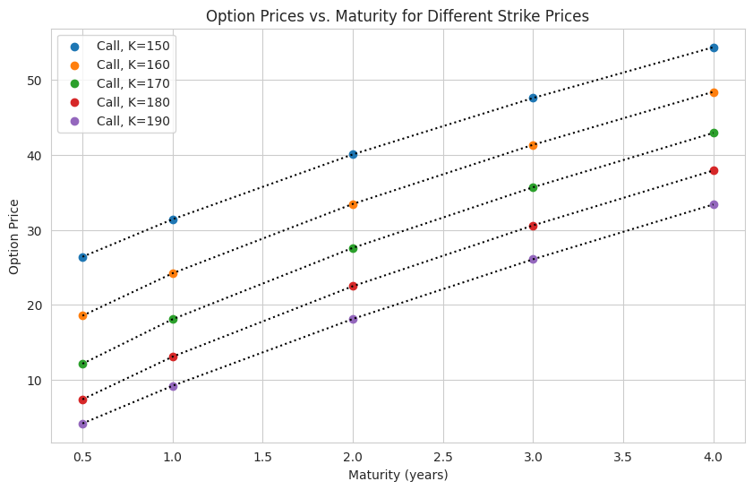
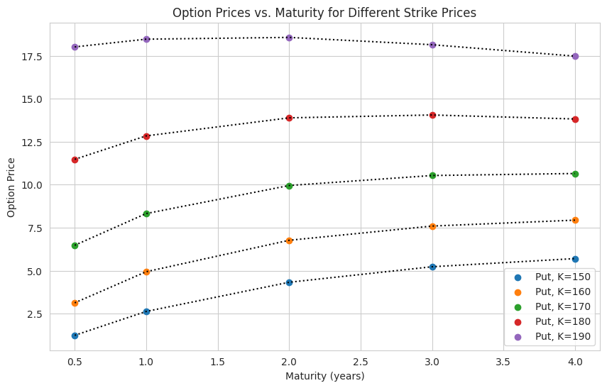
Call and Put Option Prices
These are the graphs for different strike prices and times of maturities.
Call Options
Put Options

Slide 8
Black Scholes Model
Certain assumptions :
It works on European options that can only be exercised at expiration.
No dividends.
Stock markets are efficient.
The risk-free rate and volatility of the underlying are known and constant.
The returns on the underlying are normally distributed.

Slide 9
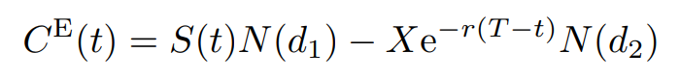
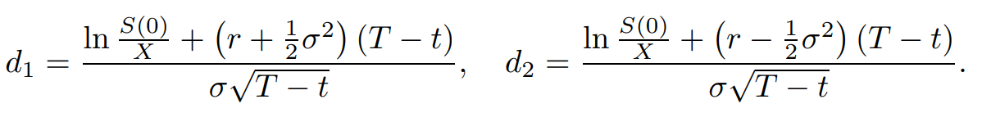
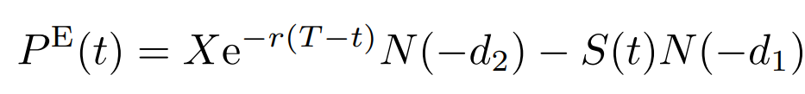
Option Price | Black Scholes
The time t price of a European call with strike price X and exercise time T, where t < T is given by

Slide 10
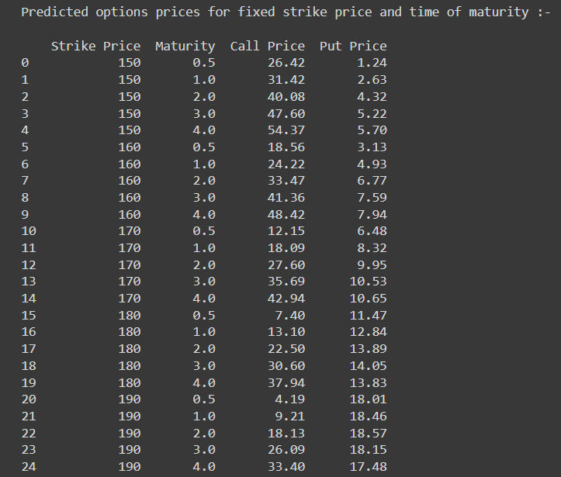
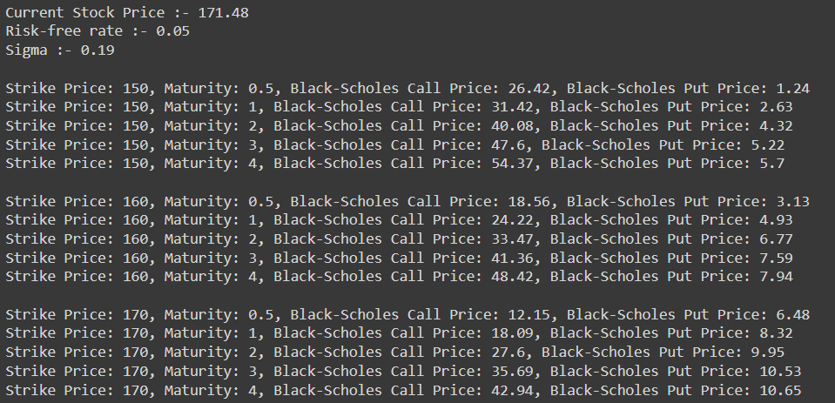
Option Price | Black Scholes
We have estimated the call and put prices i.e. C(0) and P(0) for different strike prices and time of maturities.
We have used the black scholes model for the calculation of call and put options prices.

Slide 11


Option Price | Black Scholes
These are the graphs for different strike prices and times of maturities.
Call Options
Put Options

Slide 12
Convergence of Models
We have plotted for different step sizes in the binomial model, if the step size was odd, then we got an oscillating curve, if it was even, we got a smooth curve.
All combinations converged to the price that we got by the Black Scholes model.
With an odd number of steps, the number of up and down movements is not symmetric, leading to oscillations in the resulting option prices.
On the other hand, with an even number of steps, the number of up and down movements is symmetric, resulting in smoother curves.

Slide 13
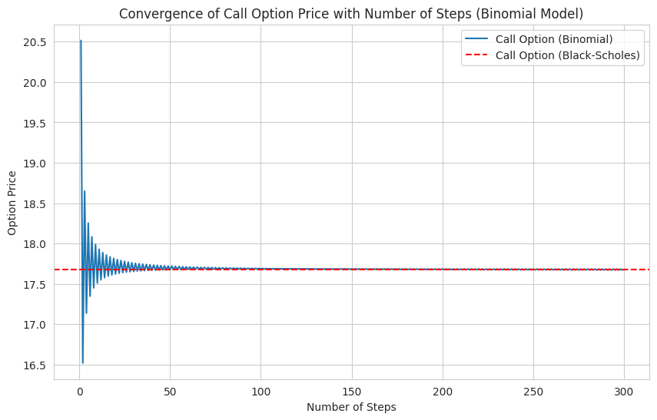
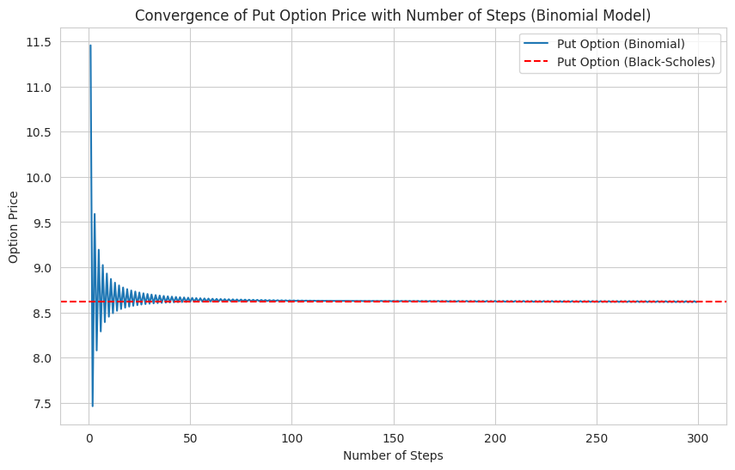
Convergence of Models
Time intervals varying from 1 to 300, with step size = 1.
Call Options
Put Options

Slide 14
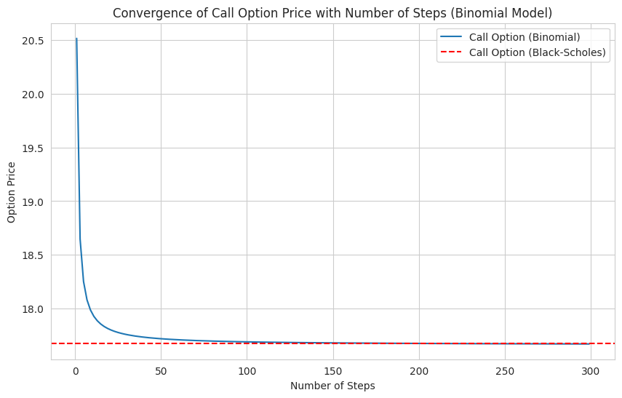
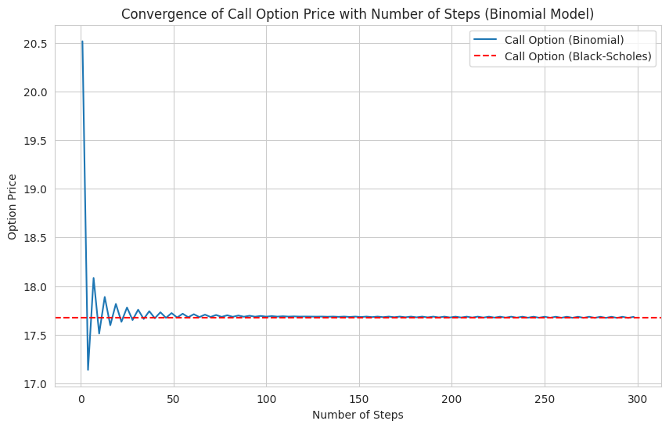
Convergence of Models
step size = 2
step size = 3

Slide 15
Comparison with Market Data
For the comparison of call and put prices that we got using the binomial model and black Scholes model, we have used 3 different expiry dates.
The different expiry months are:- July 2024 (3 months from now), October 2024 (6 months from now), March 2025(11 months from now).
So from the range of strike prices on a given expiry date, we have calculated the call and put prices from our models and compared it with real market data.
We have found the mean error for call and put options for each expiry data.

Slide 16
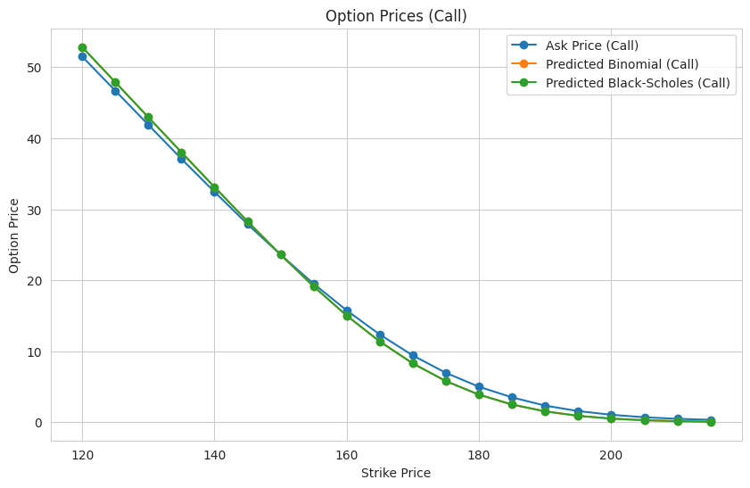
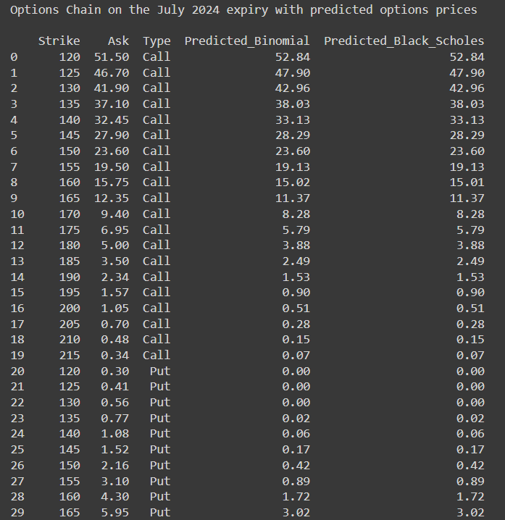
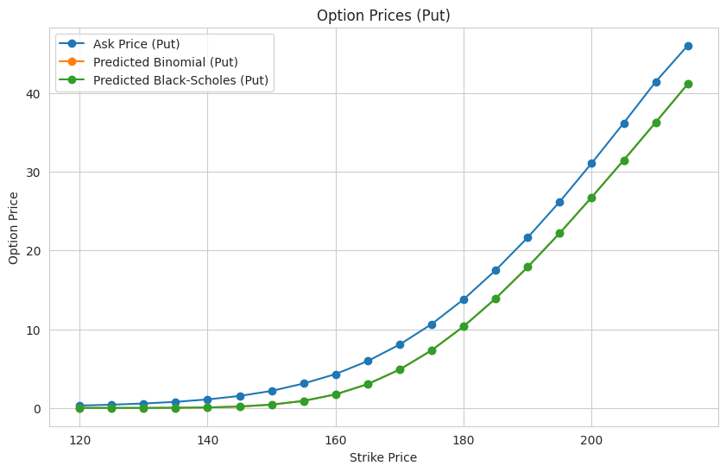
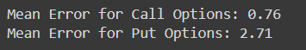
July 2024 Expiry

Slide 17
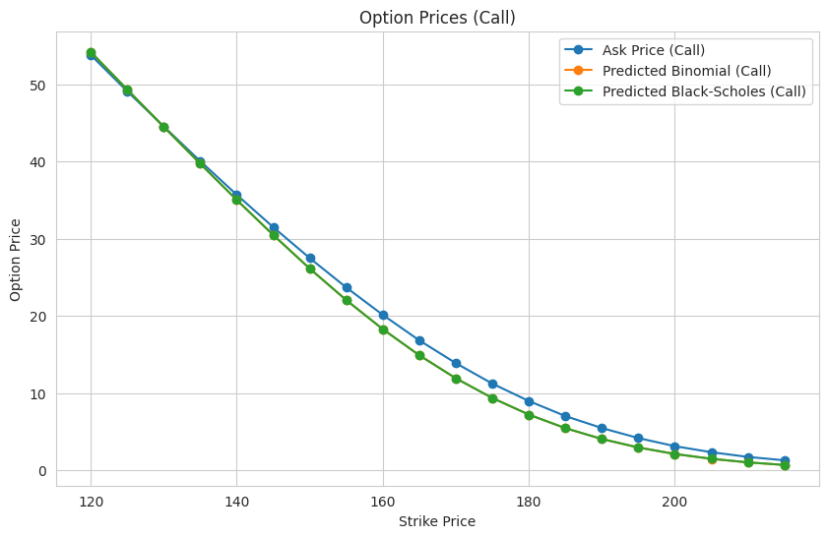
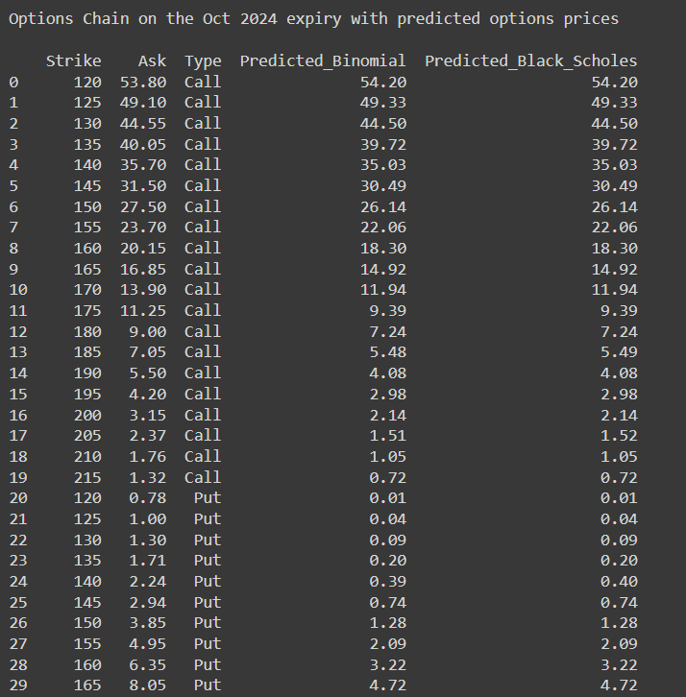
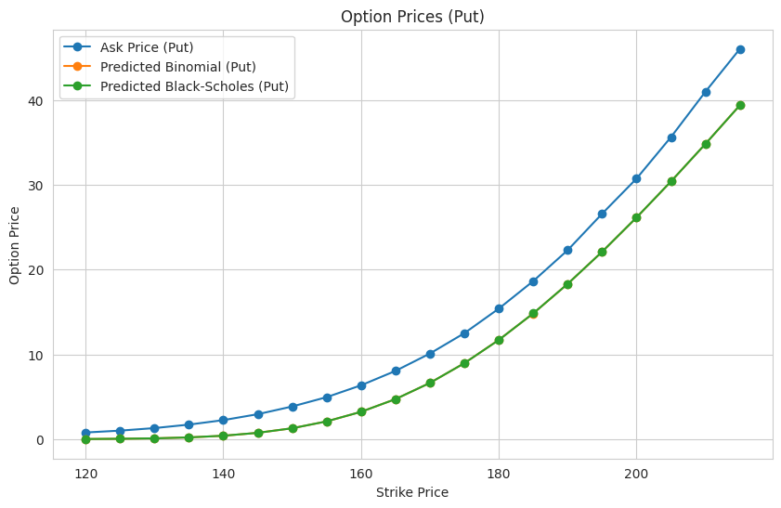
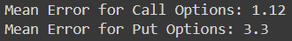
October 2024 Expiry

Slide 18
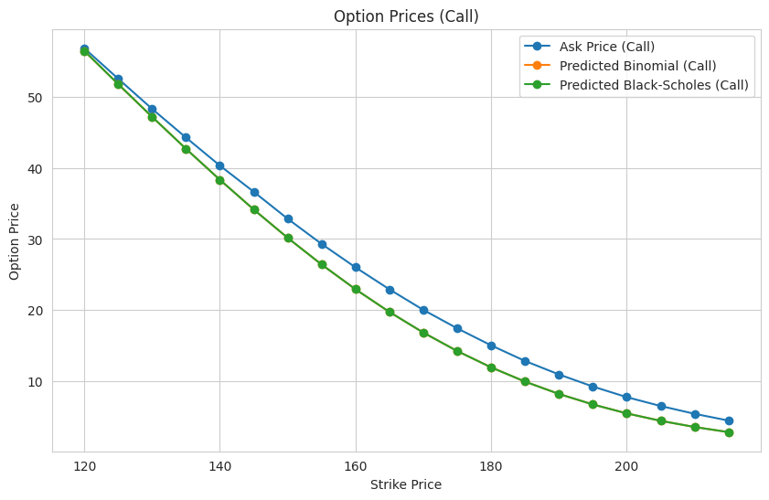
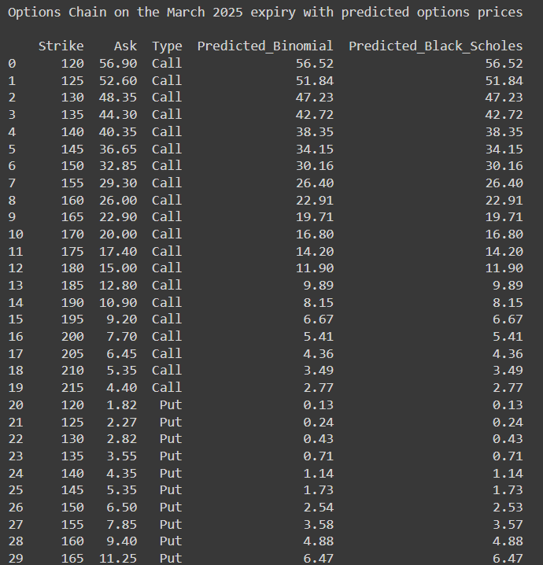
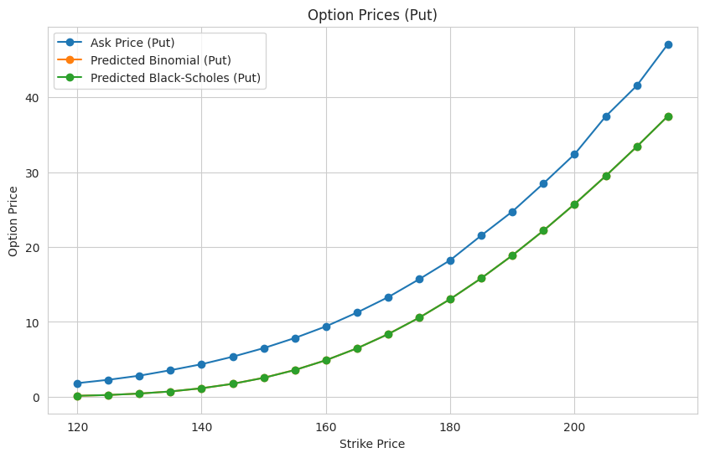
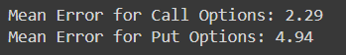
March 2025 Expiry

Slide 19
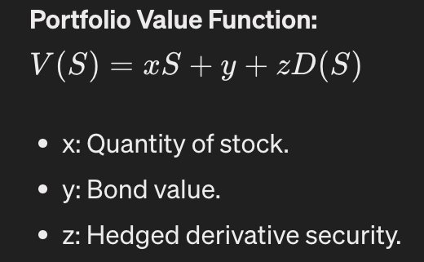
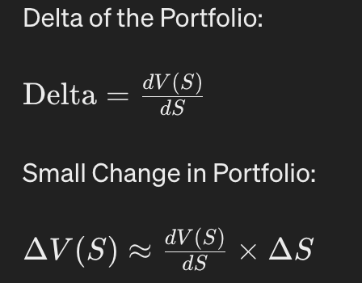
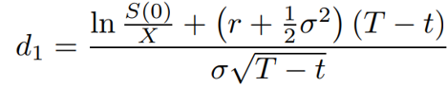
Delta Neutral Portfolio
A delta-neutral portfolio minimizes the impact of small price variations in underlying assets on the portfolio’s overall value.
Delta hedging strategies embed derivative securities in the portfolio to minimize fluctuations.
Maintains multiple positions to balance positive and negative deltas so the overall delta of the assets totals zero.
Mathematically, delta for a call and a put option are given by:-
Δ_{call} = N(d₁) Δ_{put} = N(d₁) - 1
Where t =0

Slide 20
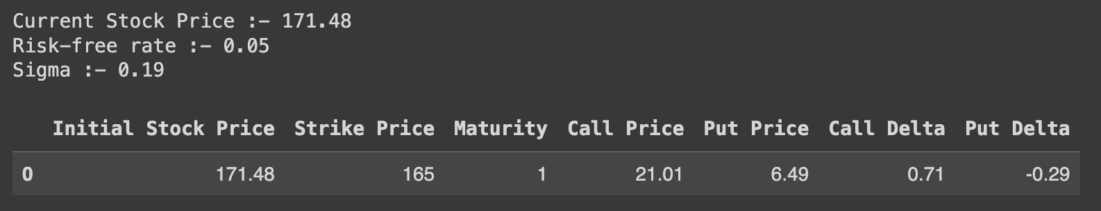
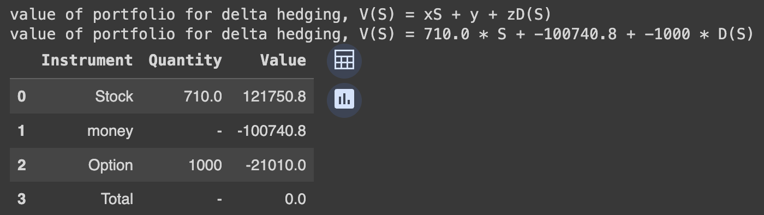
Delta Neutral Portfolio Design
Here, for AAPL stock at S₀=171.48, r=0.05 and sigma=0.19, CE=21.01 with Δ_{call} = 0.71
Aim is to design a delta neutral portfolio V_{(S)} = xS₍₀₎ + y + zD_{(S)} at t=0
Z = lot size of option = 1000
X = delta * lot size = 710, (we will hedge the portfolio by buying x amount of stock)
Y = borrow = Z*D_{(S)} - X*S₍₀₎
Note:- The overall value of the portfolio V_{(S)} = 0.

Slide 21
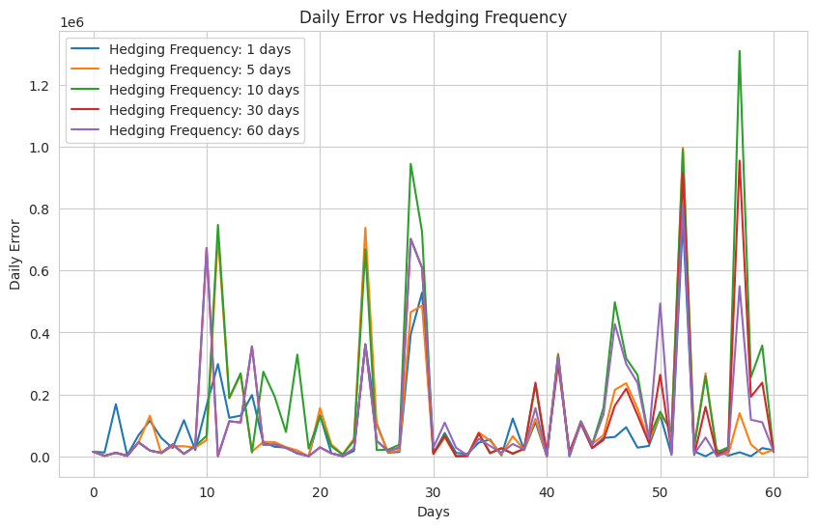
Delta Hedging Strategy
As time passes, the stock price moves/changes. This will affect the delta value of the stock option.
This change changes the value of V(S), as option price and stock price varies.
We have measured this change as Mean squared error in terms of (total change = OP + SP)^2.
As hedging frequencies increases, this error decreases, but hedging (readjustment) the portfolio, requires addition transaction costs.

Slide 22
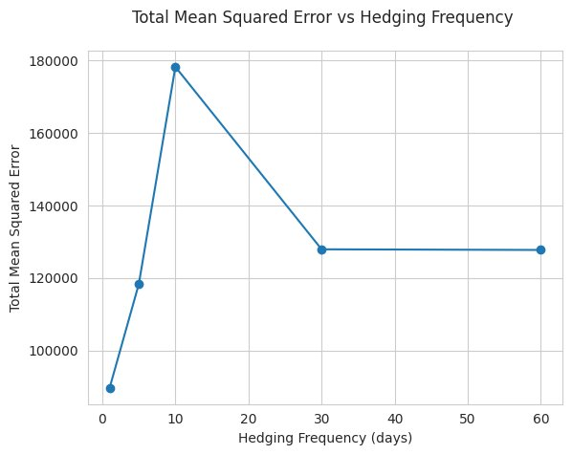
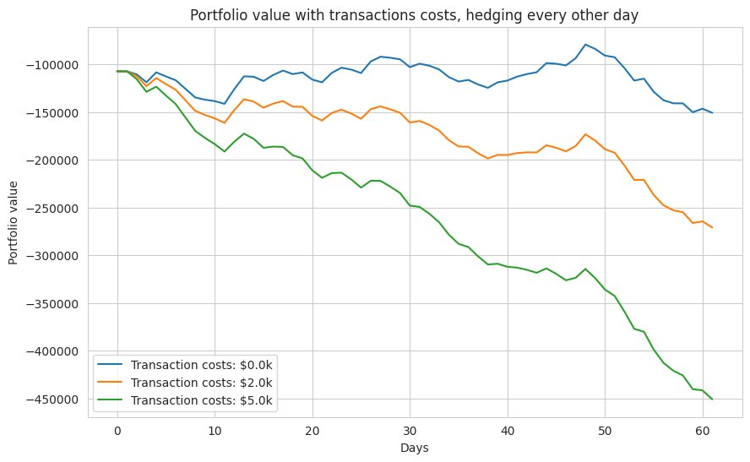
Delta Hedging Strategy
Portfolio is readjusted after every given no. of days.
The new delta of the portfolio is calculated and new values for x, y, and z are designed.
This example shows how delta hedging is used in options trading to hedge against price volatility using a single stock in the portfolio.

Slide 23
Implied Volatility
Implied volatility is crucial in approximating the future value of the option, by taking into account its current value. Options with high implied volatility have higher premiums and vice versa.
Pros:-
Implied volatility gives a clear picture of the supply and demand of an asset. When an asset is in high demand, the price tends to rise. So does the implied volatility, which leads to a higher option premium due to the risky nature of the option.
Cons:-
Based solely on prices, not fundamentals
Sensitive to unexpected factors, news events
Numerical Method:-
Employed the Newton-Raphson method to numerically calculate the Implied Volatility.
Incorporates elements of search and descent

Slide 24
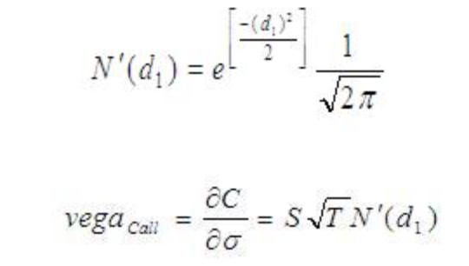
Implied Volatility (Numerical Method)
Steps Involved :-
Initial Guess: Starts with an initial guess for implied volatility (sigma)
Option Pricing: Calculates the theoretical option price using the Black-Scholes model based on the current guess for volatility.
Vega Calculation: Calculates the Vega value.
Difference Calculation: Calculates the difference between the theoretical option price and the market price.
Convergence Check: Checks if the absolute difference between the theoretical and market prices is less than the specified tolerance. If it is, it returns the current volatility guess because it has converged.
Update Guess: Adjusts the volatility guess (sigma) based on the difference between the theoretical and market prices, divided by the Vega. This adjustment aims to bring the theoretical price closer to the market price.
Iteration: Iterates through steps 2-6 until either convergence is reached or the maximum number of iterations is reached.
Vega Function :-
Measures the rate of change of option’s value (premium) with every percentage change in volatility.
Always positive for both calls and puts.

Slide 25
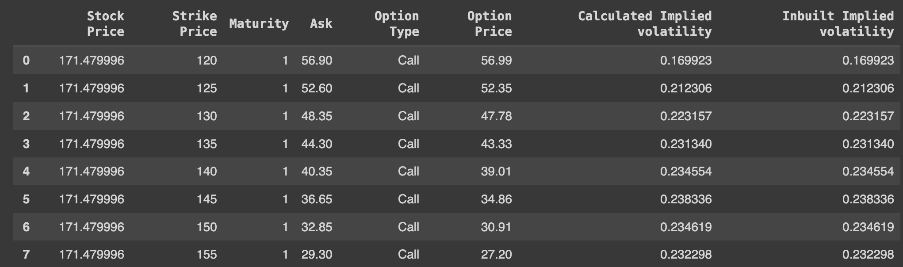
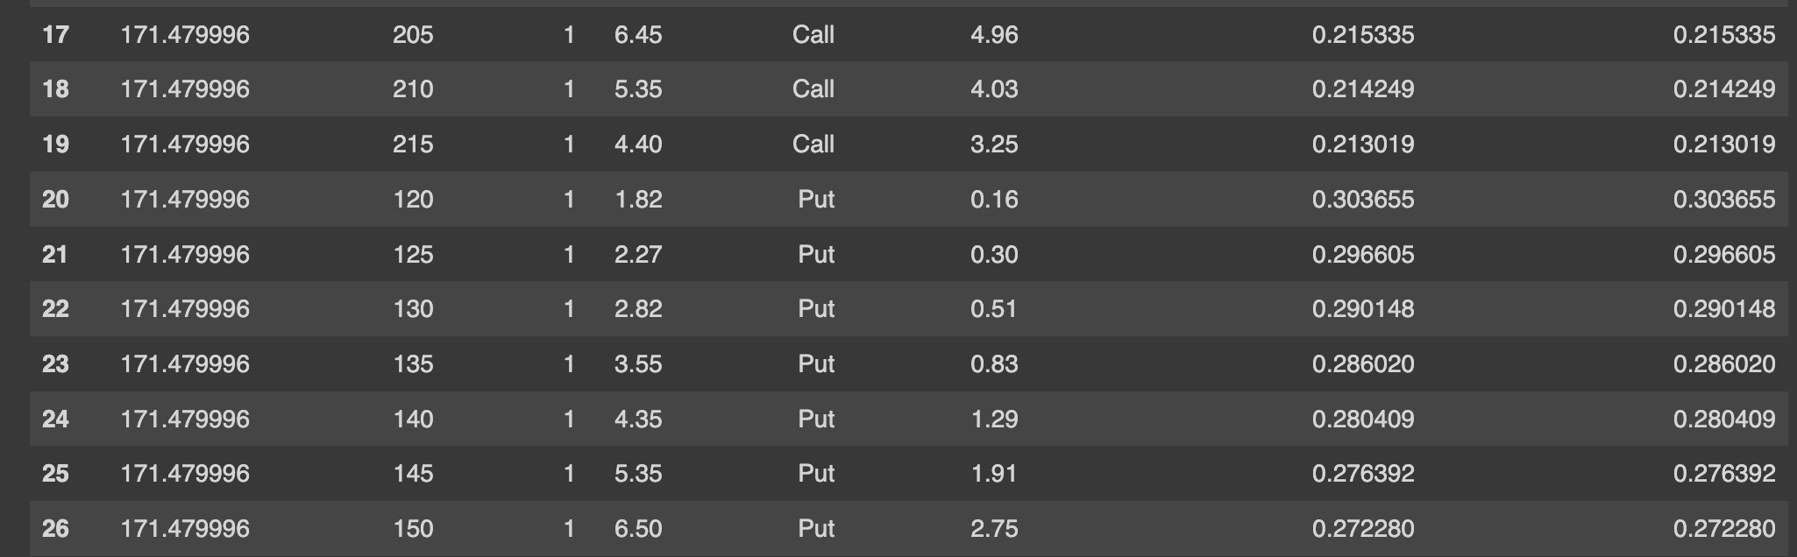
Implied Volatility (Numerical Method)

Slide 26
THANK YOU
Group Members :
Chennamsetty Ushakiran (B20MT014)
Saurabh Kumar (B20CS062)
Shubham Kumar (B20CS069)
Tanisha Jain (B20CS093)

